Slide 1
Davis-Thompson Foundation Virtual Seminars Evaluation Form: Dermatopathology
Thursday, May 28, 2020

Slide 2
128
Total Responses
Date Created: Saturday, May 23, 2020
Complete Responses: 128

Slide 3
Q1: What is your specialty?
Word cloud: Most common words shown

Slide 4
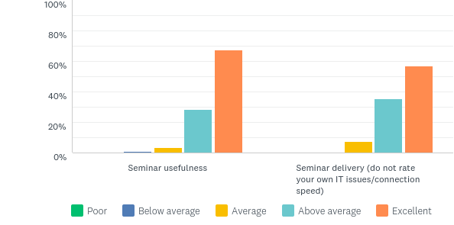
Q2: Please evaluate the following:
Answered: 127 Skipped: 1

Slide 5
Q2: Please evaluate the following:
Answered: 127 Skipped: 1

Slide 6
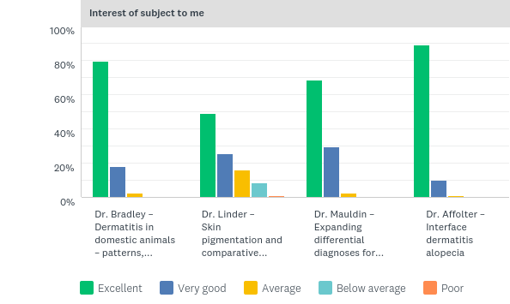
Q3: Faculty evaluation
Answered: 128 Skipped: 0

Slide 7
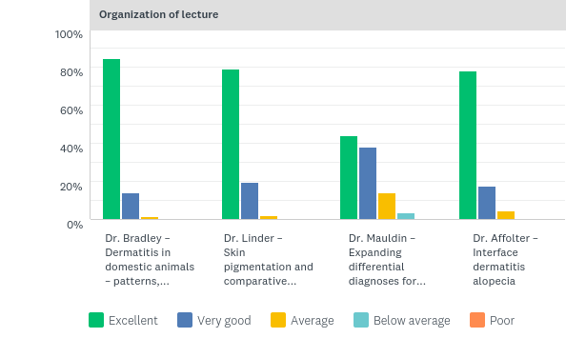
Q3: Faculty evaluation
Answered: 128 Skipped: 0

Slide 8
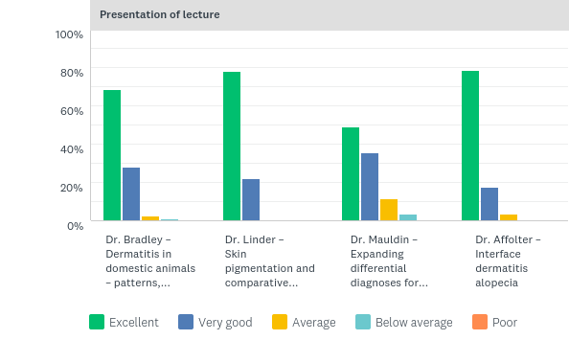
Q3: Faculty evaluation
Answered: 128 Skipped: 0

Slide 9
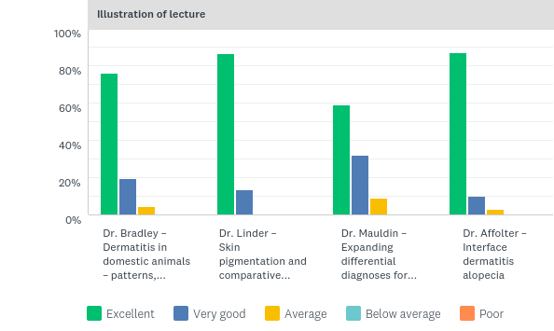
Q3: Faculty evaluation
Answered: 128 Skipped: 0

Slide 10
Q3: Faculty evaluation
Answered: 128 Skipped: 0

Slide 11
Q3: Faculty evaluation
Answered: 128 Skipped: 0

Slide 12
Q3: Faculty evaluation
Answered: 128 Skipped: 0

Slide 13
Q3: Faculty evaluation
Answered: 128 Skipped: 0

Slide 14
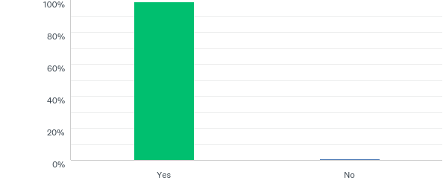
Q4: Did the Seminar meet your expectations?
Answered: 127 Skipped: 1

Slide 15
Q4: Did the Seminar meet your expectations?
Answered: 127 Skipped: 1

Slide 16
Q6: Do you have a suggestion for future topics?
Word cloud: most common words shown

